Slide 1

Transform Data with
Notes:
After collecting and loading data, almost all datasets need to be cleaned in some way. The dplyr package provides functions to carve, expand, and collapse a data frame that will cover 95% of use cases.

Slide 2

Exercise 1
Open 02-Transform.Rmd Run the setup chunk
01:00

Slide 3
Orders data set
Outpatient lab test orders
45,000 rows x 17 columns
library(tidyverse)
library(readxl)
orders <- read_excel("data/orders_data_set.xlsx")
Notes:
The data set for this lesson is derived from orders for clinical laboratory tests in an electronic health record system in a set of outpatient clinics. The orders were deidentified and time-shifted (and approved for use as a teaching resource).
One could have many different goals for analyzing this data . One may be interested in:
Volumes off tests, and where they are being ordered from
How ordersets are driving test utilization
The turnaround time between different phases of testing
Trends in cancelation and their causes
The tools I am about to present to you are agnostic to these and can be used to address the vast majority of types of questions one could ask abuot standard data sets derived from electronic health data.

Slide 4
Variable | Description
order_id | Key for order
patient_id | Key for patient
description | Text description of lab test
proc_code | Procedure code for lab test
order_class_c_descr | Setting test is intended to be performed in (eg. Normal = regular blood draw)
lab_status_c | Code for status of laboratory result
lab_status_c_descr | Status of laboratory result
order_status_c | Code for status of order
order_status_c_descr | Status of order
reason_for_canc_c | Code for cancellation reason (if applicable)
reason_for_canc_c_descr | Cancellation reason (if applicable)
order_time | Timestamp for time of original test order
result_time | Timestamp for most recent result in the record
review_time | Timestamp for provider acknowledgment of review of result
department | Clinic associated with test order
ordering_route | Structure/menu in health record from which order was placed
pref_list_type | Category of preference list (if applicable)
Notes:
Because some of you may not be familiar with this type of data, we include a small data dictionary below to explain some of the data.
There are some column pairs with very similar names: one variable is a code ("_c") and the other is a description ("_c_descr"). This is largely done for convenience in querying the data or subsetting it without typing long strings.

Slide 5
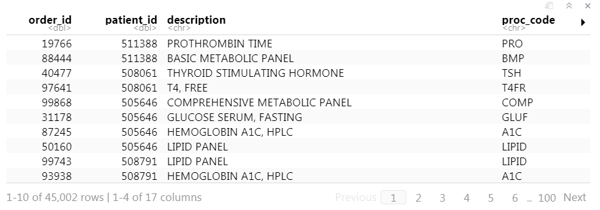
orders
Notes:
To get a very quick and high-level understanding of the dataset simply type the name of the variable containing the dataset and execute it. Rstudio will provide an interactive representation of the data as a quick glance into what is contained in the variable.
In our case, execute the code chunk containing the word ‘orders.’ You will see a short summary of the data appear below the code chunk.

Slide 6
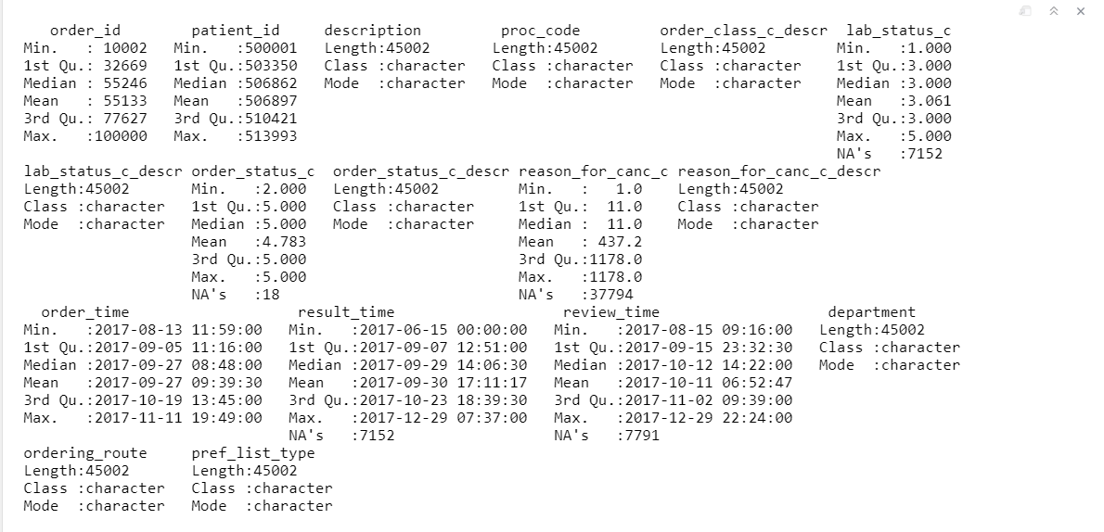
summary(orders)
Notes:
Alternatively, one could use the ‘summary()’ function on the ‘orders’ data frame. This will provide a more comprehensive and statistical picture of the data in each column of the data frame.

Slide 7

The Data Analysis Process

Slide 8
The Data Analysis Process
Visualize
Import
Tidy
Model
Communicate
Transform

Slide 9
“Happy families are all alike; every unhappy family is unhappy in its own way.”
–– Leo Tolstoy
“Tidy datasets are all alike, but every messy dataset is messy in its own way.”
–– Hadley Wickham

Slide 10
dplyr
dplyr implements a grammar for transforming tabular data.
Notes:
Getting your data into this format requires some upfront work, but that work pays off in the long term. Once you have tidy data and the tidy tools provided by packages in the tidyverse, you will spend much less time munging data from one representation to another, allowing you to spend more time on the analytic questions at hand. The dplyr package provides functions that begin this process, they help you carve, expand, and collapse data.

Slide 11
common syntax
Each function takes a data frame as its first argument and returns a data frame as its output.
filter(data, ...)
dplyr function
data frame to transform
specific arguments

Slide 12
Isolating data
Extract variables with select()
Extract rows with filter()
Arrange rows, with arrange().
Notes:
We will start with three functions that are handy ways to find the data you’re interested in the large laboratory datasets regularly dumped on you. Reducing a data set to a subset of columns and/or rows are common operations, particularly on the path to answering a specific set of questions about a data set.

Slide 13

select()
Notes:
We will start slowly, with the select function.It’s not uncommon to get datasets with hundreds or even thousands of variables. In this case, the first challenge is often narrowing in on the variables you’re actually interested in. select() allows you to rapidly zoom in on a useful subset using operations based on the names of the variables.

Slide 14
select()
Extract columns from a data frame
select(data,... )
data frame to transform
name(s) of columns to extract
(or a select helper) function)
data frame to transform
Notes:
The first dplyr function we’ll look at is select(). Select extracts columns from a data frame.
Select takes a data frame as its first argument.
After that it takes any number of additional arguments that specify the columns that you want to pick. In it’s simplest form, those additional arguments will just be the names of the columns that you want to select. However, in very wide datasets, writing out the names of the columns you want can sometimes be laborious. It doesn’t scale well. That’s why the developers of the dplyr function have added several convenience functions that can more succinctly identify the columns you want. We’ll cover that after the next exercise.

Slide 15
select()
Extract columns by name.
select(data,... )
select(orders, description, department)
data frame to transform
name(s) of columns to extract
(or a select helper) function)
data frame to transform
Notes:
Let’s take a look at the orders data frame that we loaded earlier in the lesson, for example.
The select statement will take the data frame ‘orders’, and return a new data frame that only has the columns description and department. You could list as many or as few column names as you want in the select function, it will bring back everything you list.

Slide 16
select()
Extract columns by name.
select(orders, description, department)
orders
description | department
PROTHROMBIN TIME | INTERNAL MEDICINE CLINIC
BASIC METABOLIC PANEL | INTERNAL MEDICINE CLINIC
THYROID STIMULATING HORMONE | ENDOCRINOLOGY CLINIC
T4, FREE | ENDOCRINOLOGY CLINIC
order_id | patient_id | description | proc_code | department
19766 | 511388 | PROTHROMBIN TIME | PRO | INTERNAL MEDICINE CLINIC
88444 | 511388 | BASIC METABOLIC PANEL | BMP | INTERNAL MEDICINE CLINIC
40477 | 508061 | THYROID STIMULATING HORMONE | TSH | ENDOCRINOLOGY CLINIC
97641 | 508061 | T4, FREE | T4FR | ENDOCRINOLOGY CLINIC
description | department
PROTHROMBIN TIME | INTERNAL MEDICINE CLINIC
BASIC METABOLIC PANEL | INTERNAL MEDICINE CLINIC
THYROID STIMULATING HORMONE | ENDOCRINOLOGY CLINIC
T4, FREE | ENDOCRINOLOGY CLINIC
Notes:
So, if you were to use the code above, the orders data frame would be accepted as input and a subset of it, the Description and the Department columns would be returned as output

Slide 17
select()
Extract columns by index.
select(orders, c(1,4))
orders
description | department
PROTHROMBIN TIME | INTERNAL MEDICINE CLINIC
BASIC METABOLIC PANEL | INTERNAL MEDICINE CLINIC
THYROID STIMULATING HORMONE | ENDOCRINOLOGY CLINIC
T4, FREE | ENDOCRINOLOGY CLINIC
order_id | patient_id | description | proc_code | department
19766 | 511388 | PROTHROMBIN TIME | PRO | INTERNAL MEDICINE CLINIC
88444 | 511388 | BASIC METABOLIC PANEL | BMP | INTERNAL MEDICINE CLINIC
40477 | 508061 | THYROID STIMULATING HORMONE | TSH | ENDOCRINOLOGY CLINIC
97641 | 508061 | T4, FREE | T4FR | ENDOCRINOLOGY CLINIC
order_id | proc_code
19766 | PRO
88444 | BMP
40477 | TSH
97641 | T4FR
Notes:
Select is very flexible in terms of the ways that you can specify the columns you do or don’t want in the output. Here I’m showing you that I can give a numeric index of the columns that I want, in this cases the first and the fourth, and select dutifully provides these in the output. Note that when listing out these indexes one should put them in the ‘c’ (which stands for concatenate) function.

Slide 18
Exercise 2
Alter the code to select just the order_status_c column using the (1) column name and the (2) column number:
select(orders,description, department)
02:00

Slide 19
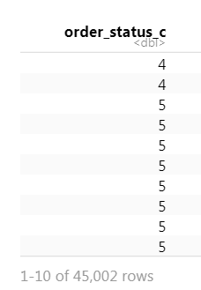
select(orders,order_status_c)
select(orders,8)

Slide 20
select() helpers
: Select range of columns
select(orders, order_id:lab_status_c)
– Select every column but
select(orders, -c(description, order_status_c))
starts_with() Select columns that start with…
select(orders, starts_with("order"))
ends_with() Select columns that end with…
select(orders, ends_with(“descr"))
Notes:
Select provides many convenient ways to specify which columns you want. For instance, you can put the name of two columns separated by a colon mark, and select will return those two columns and all those in between. With select you could put a negative sign in front of a column name or a vector of column names and you'll get back everything except those columns. Then there's other functions that you can use inside of select that provide even more flexibility around defining which columns you want. For instance, you can use special function like starts_with and ends_with to instruct select on which columns you want based on a string.

Slide 21
select() helpers
: Select range of columns
select(orders, order_id:lab_status_c)
– Select every column but
select(orders, -c(description, order_status_c))
starts_with() Select columns that start with…
select(orders, starts_with("order"))
ends_with() Select columns that end with…
select(orders, ends_with(“descr"))
Notes:
Select provides many convenient ways to specify which columns you want. For instance, you can put the name of two columns separated by a colon mark, and select will return those two columns and all those in between. With select you could put a negative sign in front of a column name or a vector of column names and you'll get back everything except those columns. Then there's other functions that you can use inside of select that provide even more flexibility around defining which columns you want. For instance, you can use special function like starts_with and ends_with to instruct select on which columns you want based on a string.

Slide 22
select() helpers
contains() Select columns whose names contain…
select(orders, contains("time"))
matches() Select columns whose names match regular expression
select(orders, matches("^.{4}$"))
num_range() Select columns named in prefix, number style
select(orders, num_range("x“,1:5))
: Select range of columns
Notes:
Listed here are additional select helper functions. You can see they allow you to pull out columns whose names have a certain string in them or that match a certain regular expression. If you have a very large data set with many columns selecting variables out of it might be an important task and these functions might make it easier for you to identify desired columns in a more automated fashion.

Slide 23
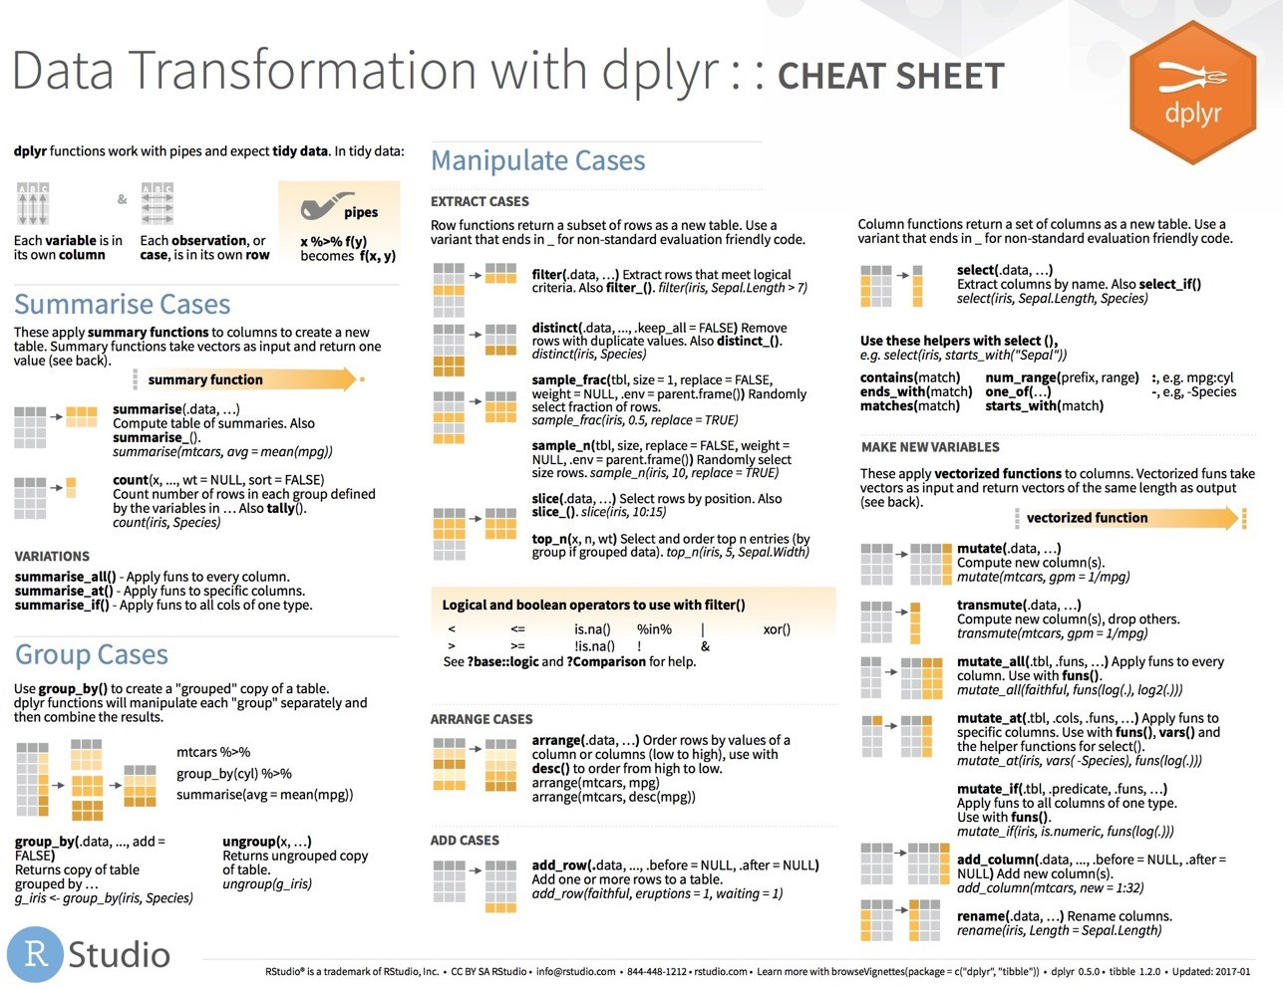
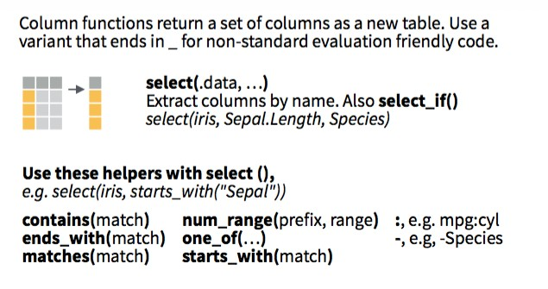

select() helpers
Notes:
I’ve only listed for you a selection of the available ways you can use helpers with select() to pull out the columns you need for your analysis. For a more complete list, see the select() section on the dplyr cheatsheet,

Slide 24
Consider #1
Which of these is NOT a way to remove the columns that represent status codes?
select(orders, -ends_with("_c"))
select(orders, -c(lab_status_c, order_status_c, reason_for_canc_c))
select(orders, -c(6,8,10))
select(orders, -contains("status"))
01:00

Slide 25
Consider #1
Which of these is NOT a way to remove the columns that represent status codes?
select(orders, -ends_with("_c"))
select(orders, -c(lab_status_c, order_status_c, reason_for_canc_c))
select(orders, -c(6,8,10))
select(orders, -contains("status"))

Slide 26
filter()
Notes:
Now let's carve the data set in the other direction. If you need only a subset of rows from your data set, `filter()` allows you to pick rows (cases) based on values, ie. you can subset your data based on logic.

Slide 27
filter()
Extract rows that meet logical criteria.
filter(data,... )
one or more logical tests (filter returns each row for which the test is TRUE)
data frame to transform
Notes:
The syntax for filter is very similar to what we used for select. The first argument is a data frame from which we will be selecting rows. Afterwards we can input one more logical tests. R then performs that logical test on each row of the dataset and returns all rows in which the logical test was TRUE. Rows for which the tests are TRUE are returned in the output.

Slide 28
filter()
Extract rows that meet logical criteria.
filter(orders, patient_id==508061)
order_id | patient_id | description | proc_code
19766 | 511388 | PROTHROMBIN TIME | PRO
88444 | 511388 | BASIC METABOLIC PANEL | BMP
40477 | 508061 | THYROID STIMULATING HORMONE | TSH
97641 | 508061 | T4, FREE | T4FR
order_id | patient_id | description | proc_code
40477 | 508061 | THYROID STIMULATING HORMONE | TSH
97641 | 508061 | T4, FREE | T4FR
data frame to transform
Notes:
The syntax for filter is very similar to what we used for select. The first argument is a data frame from which we will be selecting rows. Afterwards we can input one more logical tests. R then performs that logical test on each row of the dataset and returns all rows in which the logical test was TRUE. Rows for which the tests are TRUE are returned in the output.

Slide 29
filter()
Extract rows that meet logical criteria.
filter(orders, patient_id==508061)
order_id | patient_id | description | proc_code
19766 | 511388 | PROTHROMBIN TIME | PRO
88444 | 511388 | BASIC METABOLIC PANEL | BMP
40477 | 508061 | THYROID STIMULATING HORMONE | TSH
97641 | 508061 | T4, FREE | T4FR
= sets
(returns nothing)
== tests if equal
(returns TRUE or FALSE)
data frame to transform
Notes:
Note that I used double equals inside of the filter function. Double equals means: compare the left hand side to the right hand side and if it’s the same, then return TRUE. The double equals is called the comparison operator. In contrast, a single equals sign sets a value to another. It is a very common mistake to accidentally use a single equals inside of the filter function, which will result in an error.

Slide 30
filter()
Extract rows that meet logical criteria.
filter(orders, proc_code=="BMP")
order_id | patient_id | description | proc_code
19766 | 511388 | PROTHROMBIN TIME | PRO
88444 | 511388 | BASIC METABOLIC PANEL | BMP
40477 | 508061 | THYROID STIMULATING HORMONE | TSH
97641 | 508061 | T4, FREE | T4FR
order_id | patient_id | description | proc_code
88444 | 511388 | BASIC METABOLIC PANEL | BMP
55526 | 511303 | BASIC METABOLIC PANEL | BMP
69809 | 509686 | BASIC METABOLIC PANEL | BMP
24316 | 503847 | BASIC METABOLIC PANEL | BMP
= sets
(returns nothing)
== tests if equal
(returns TRUE or FALSE)
Notes:
Similarly we can ask filter to return just the rows that represent a specific test being ordered, like a BMP. Note that when asking filter to return rows with specific text inside of it, we have to put that text in quotes.

Slide 31
Logical tests
?Comparison
x < y | Less than
x > y | Greater than
x == y | Equal to
x <= y | Less than or equal to
x >= y | Greater than or equal to
x != y | Not equal to
x %in% y | Group membership
is.na(x) | Is NA
!is.na(x) | Is not NA
Notes:
Here are some important logical operators to know about. They will all come in handy when you’re filtering rows of a data frame.
We’ve already seen the double equals. Note the less than or and greater than operators. These operators also come as “or equal to” versions.
Use != if you want to select rows in which a value is not equal to something else.
is.na is how you can test for missing values. Often times you want to remove missing values.

Slide 32
Your Turn 3
See if you can use the logical operators to manipulate our code to show:
All of the orders where LAB_STATUS_C_DESCR is equal to “Final result”
All Order_ID’s that are greater than 100000
All of the orders where REASON_FOR_CANC_C_DESCR is not NA
04:00

Slide 33
filter(orders, LAB_STATUS_C_DESCR == "Final result")
filter(orders, `Order ID` > 100000)
`Order ID` `Patient ID` Description `Proc Code` ORDER_CLASS_C_D… LAB_STATUS_C LAB_STATUS_C_DE…
1 40477 508061 THYROID ST… TSH Normal 3 Final result
2 97641 508061 T4, FREE T4FR Normal 3 Final result
3 99868 505646 COMPREHENS… COMP Normal 3 Final result
0 rows | 1-5 of 15 columns
filter(orders, !is.na(REASON_FOR_CANC_C_DESCR))
Order ID | Patient ID | Description | Proc Code
19766 | 511388 | PROTHROMBIN TIME | PRO
88444 | 511388 | BASIC METABOLIC PANEL | BMP
34373 | 511303 | IRON, SERUM | FE

Slide 34
Two common mistakes
1. Using = instead of ==
filter(orders, Proc Code = "COMP")
filter(orders, Proc Code == "COMP")
2. Forgetting quotes
filter(orders, Proc Code = COMP)
filter(orders, Proc Code = "COMP")

Slide 35
filter()
Extract rows that meet every logical criteria.
filter(orders, PatientID == 508061, Description==”T4, FREE”)
orders
OrderID | Patient ID | Description
19766 | 511388 | PROTHROMBIN TIME
88444 | 511388 | BASIC METABOLIC PANEL
40477 | 508061 | THYROID STIMULATING HORMONE
97641 | 508061 | T4, FREE
99868 | 505646 | COMPREHENSIVE METABOLIC PANEL
OrderID | Patient ID | Description
97641 | 508061 | T4, FREE
Notes:
Combining logical operators
You can combine tests by putting a comma in between tests and filter will combine the two statements as if there is an and statement
between them, condition A and condition B. You could formally tell filter to join the two logical tests using the ‘&’ symbol and you include an OR condition as well using the pipe character | - condition A | condition B.

Slide 36
Boolean operators
?base::Logic
a & b | and
a | b | or
!a | not
a %in% c(a, b) | one of (in)

Slide 37
select() helpers
Function | What it does | How it’s used
: | Select range of columns | select(orders, Order_ID:LAB_STATUS_C)
- | Select every column but | select(orders, -Patient_ID)
starts_with() | Select columns that start with | select(orders, starts_with("Order"))
contains() | Select columns that contain | select(orders, contains("Time"))
Notes:
alternative

